Slide 1

Git for z Systems
Hannah Neumann
Nelson Lopez
IBM DevOps Acceleration Team

Slide 2
Disclaimer
IBM’s statements regarding its plans, directions, and intent are subject to change or withdrawal without notice and at IBM’s sole discretion.
Information regarding potential future products is intended to outline our general product direction and it should not be relied on in making a purchasing decision.
The information mentioned regarding potential future products is not a commitment, promise, or legal obligation to deliver any material, code or functionality. Information about potential future products may not be incorporated into any contract.
The development, release, and timing of any future features or functionality described for our products remains at our sole discretion.
Performance is based on measurements and projections using standard IBM benchmarks in a controlled environment. The actual throughput or performance that any user will experience will vary depending upon many factors, including considerations such as the amount of multiprogramming in the user’s job stream, the I/O configuration, the storage configuration, and the workload processed. Therefore, no assurance can be given that an individual user will achieve results similar to those stated here

Slide 3
What is Git?

Slide 4
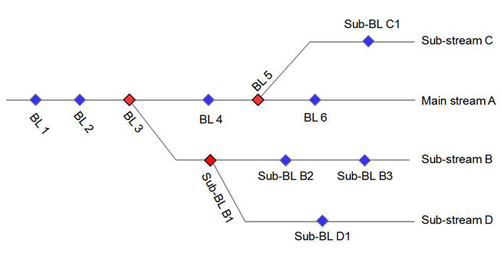
What does SCM stand for ?
Software Configuration Management is the task of tracking and controlling changes in the software
Configuration identification - Identifying configurations, configuration items and baselines.
Configuration control - Implementing a controlled change process.
Configuration auditing.
Source Control Management is a subfield of Configuration Management
Graph structure (line of development, branches).
Atomic operation, version merging, baselines, labels tags

Slide 5
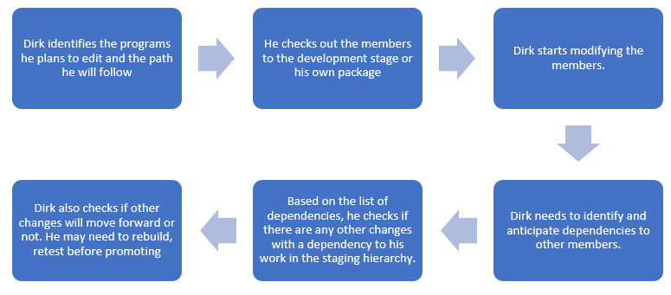
Library Managers
Relies on the concept of concatenation & promotion
Strong connection to execution environment
Limited for parallel development

Slide 6
Full configuration
“A configuration is made up of a given list of files, each of them at a given version. A configuration can have various scopes: for example, an application component, an application, a domain, or more.”
Release 11
Maint.
Release 12
Feature Branch
Feature Branch

Slide 7
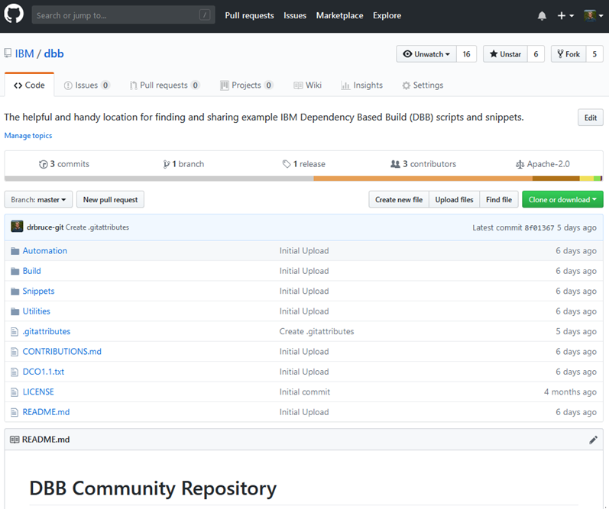
What is Git?
Open Source SCM initially built to manage Linux development
Distributed Source Code Management
Each developer works in their own local Git repository on their machine.
In most large companies today, there is a centralized instance of Git that is considered the server
Uses a commit ID instead of a version
SHA-1 hash based on the code, what came before it, who made the commit, when they made it, and other metadata
Used with other open source tools such as Jenkins, Ant, Maven, Gradle for Continuous Integration / Continuous Delivery pipeline
Strengths
Simple, cheap and easy to deploy
Pervasive in Open Source development where there is no effective competition
GitHub, GitLab, and BitBucket are common Git based web hosted repositories.

Slide 8
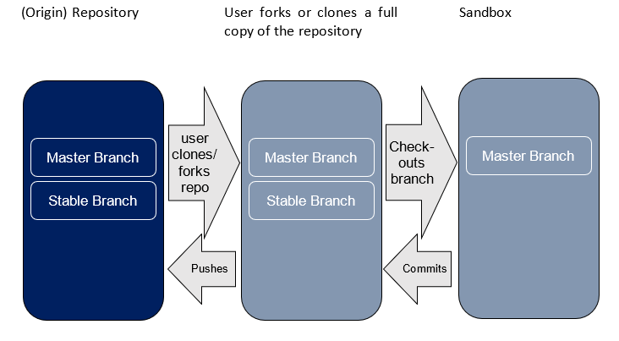
Git in a nutshell

Slide 9
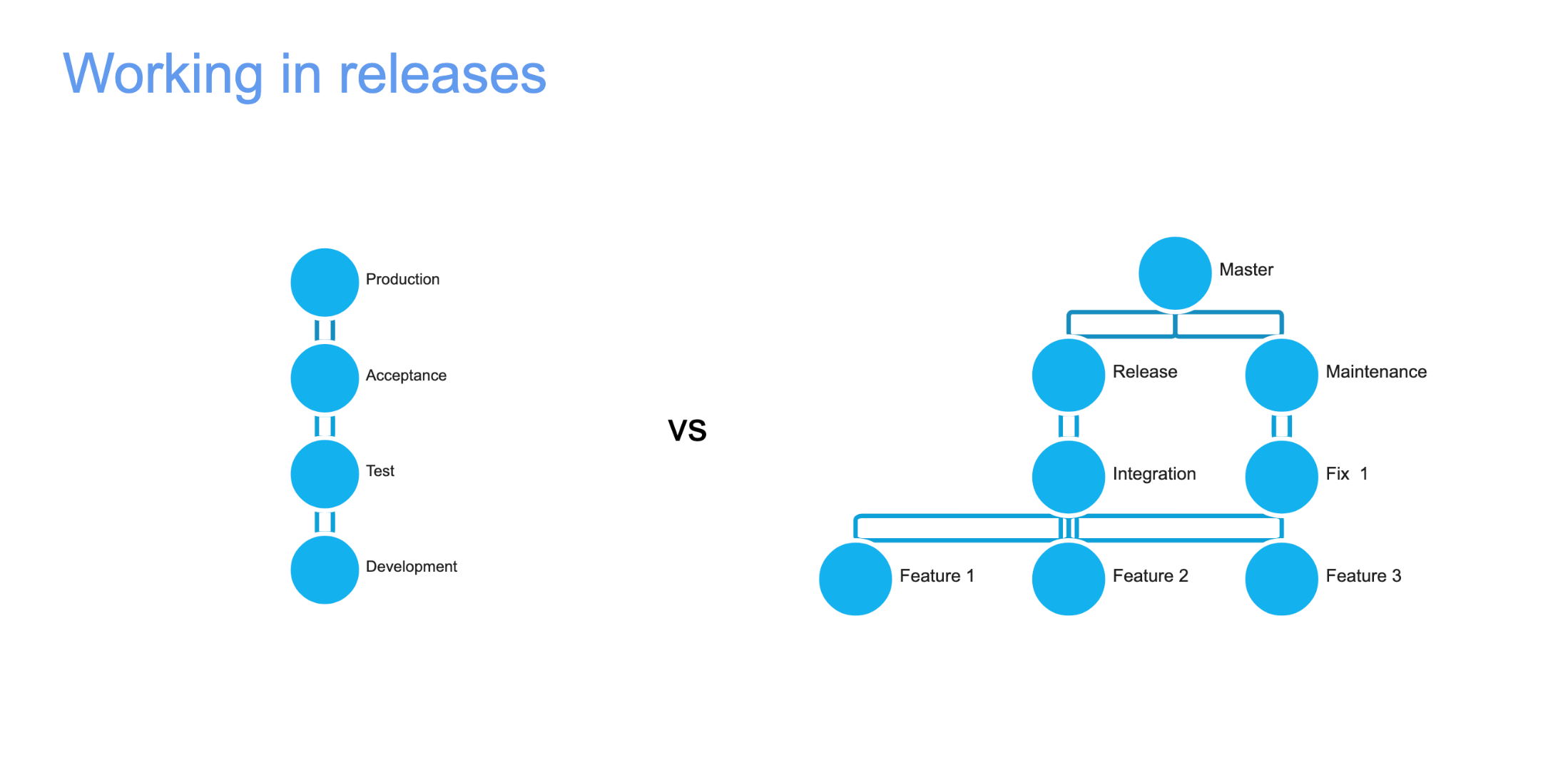

Slide 10
Using Git with IBM Dependency Based Build (DBB)

Slide 11
IBM Dependency Based Build (DBB) – Key Features
DBB is a tool that provides an Intelligent build environment for mainframe applications stored in Git.
Supports your overall CI/CD solution as well as support individual developer builds within ZOD & IDzEE.
Uses a multi-language source code scanner to find dependencies for Assembler, C/C++, COBOL, and PL/I source files to automate your build process (compile & link edit).
Comes with a Java API Tool Kit, WebApp and Database to build and manage your application’s dependency metadata and build results.
Use DBB API’s with the Groovy scripting language to automate your builds and drive your deployment process (CD)
Sample Scripts are provided to get you started

Slide 12

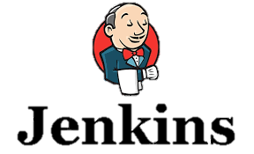



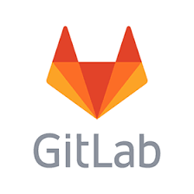




DBB Architecture Overview - CI workflow
DBB, includes a free port of Rocket Software’s Git and Apache’s Groovy runtime for z/OS. It can be configured with any DevOps orchestrator like Jenkins and any Git Host service like Git Hub.
Start Pipeline
DBB WebApp
- Dependency Metadata
- Build Results History
Status, logs and links to reports
Git Server
DBB Toolkit
Main Repository
CLONE to USS
Agent
Groovy Build scripts
USS
MVS
API’s
PDS
Scan, impact analysis, copy to PDS, compile, link-edit & report.
Compile &
link
Run Groovy build script

Slide 13
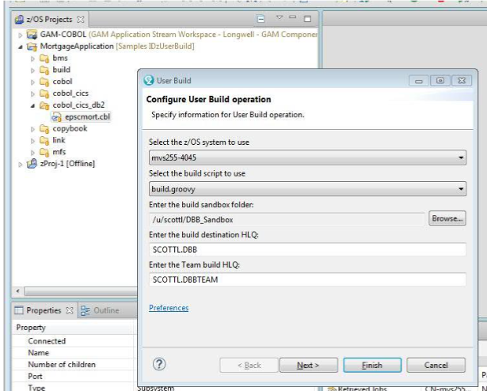
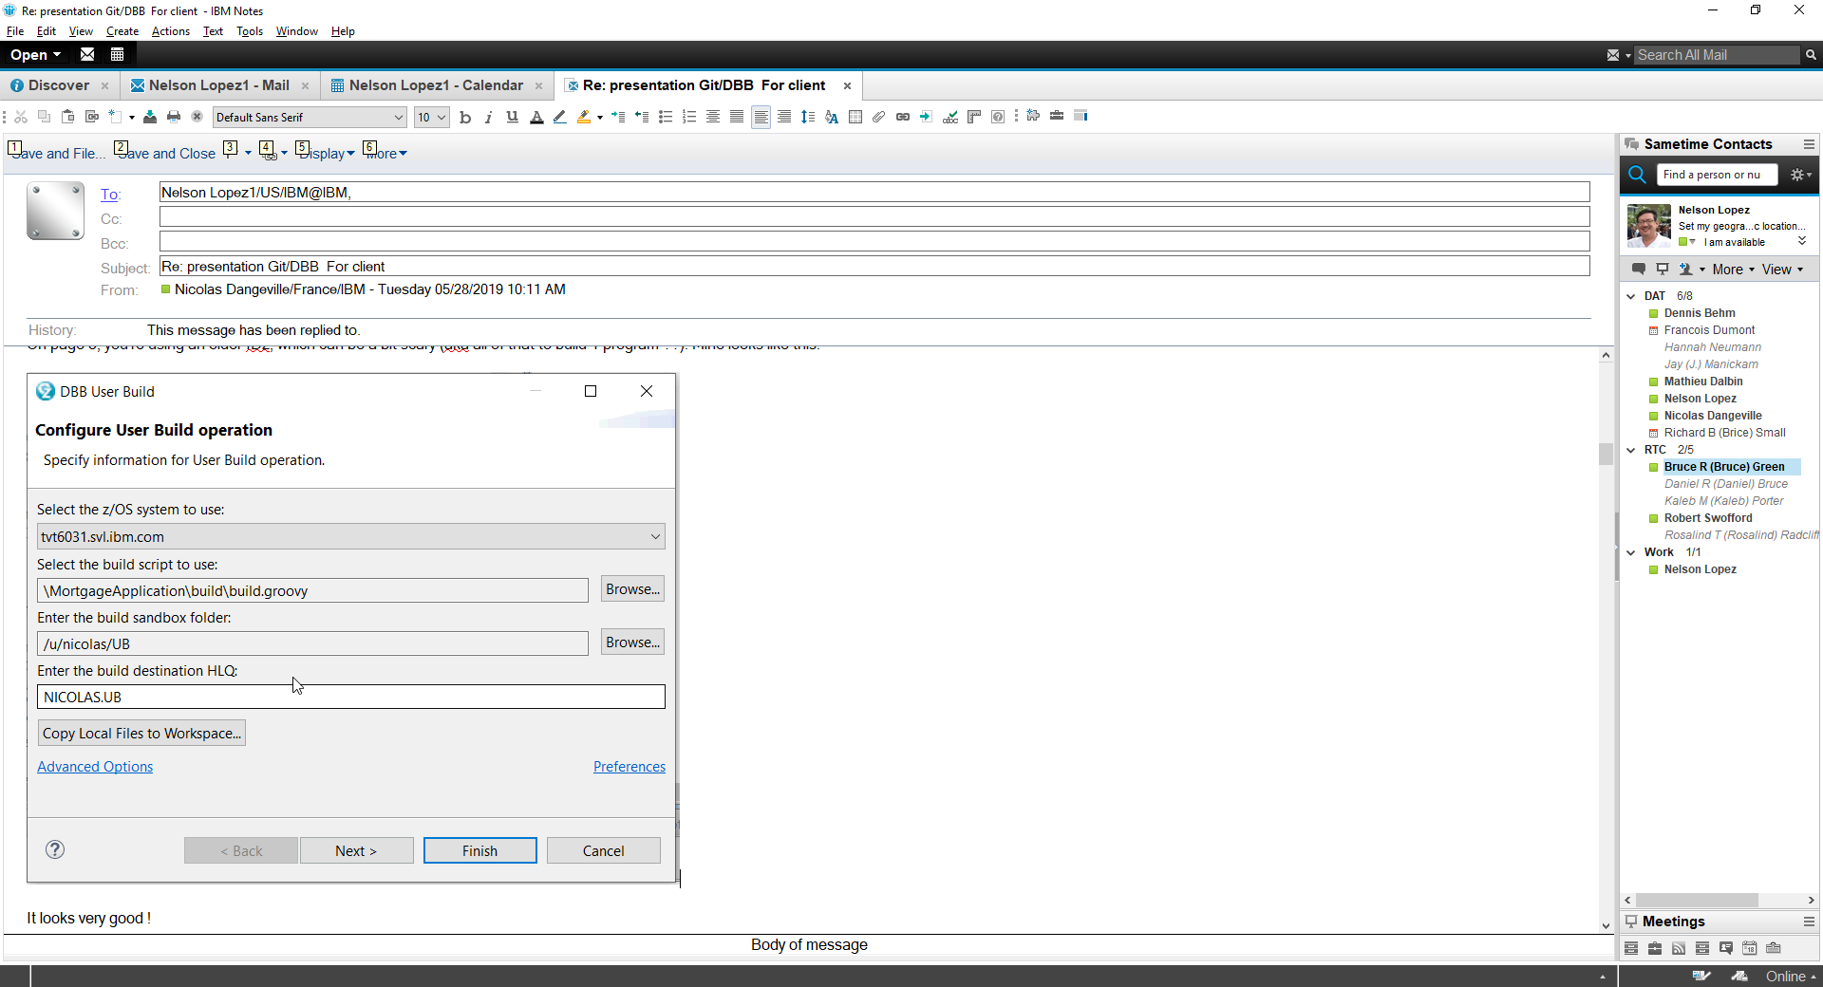
DBB and IDz – User Build
DBB can be used within IDz’s “User Build” feature
Provides all the benefits of a dependency based build
No JCL knowledge needed
Does not rely on Rocket Git or Jenkins

Slide 14


DBB Impact Build Scenarios
Here are 2 scenarios to explain how DBB works when a change is made to a sample application of, lets say, 3 programs and 3 copybooks.
If we change CYP-2, DBB will return a build-list of “PGMS A,B,C“ for the build.
If we change PGM-B, DBB will return “PGMS B & C” for a build.
Sample application and related dependencies in a Repo
DBB Result - Build List
PGM-A
CPY-1
CPY-2
Scenarios
PGM-B
PGM-A
CPY-2
Change CPY-2
PGM-C
PGM-B
CPY-3
PGM-B
PGM-C
Change PGM-B
Static Link
PGM-C

Slide 15
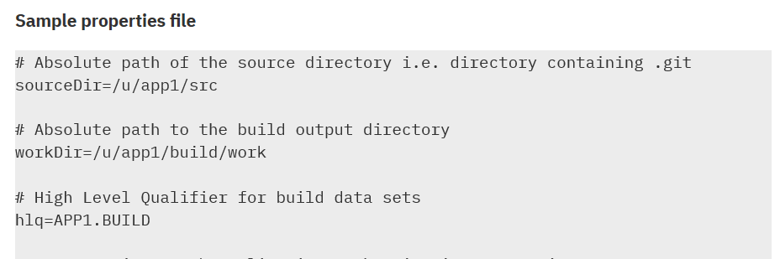
DDB – A Sample Groovy Compile Script
import com.ibm.dbb.build.*
println("Copying source from zFS to PDS . . .")
def copy = new CopyToPDS().file(new File(“$sourceDir/helloworld.cbl"))
.dataset("USR1.BUILD.COBOL").member("HELLO")
copy.execute()
println("Compiling . . .")
def compile = new MVSExec().pgm("IGYCRCTL").parm("LIB")
compile.dd(new DDStatement().name("SYSIN").dsn(“$hlq.BUILD.COBOL(HELLO)")
.options("shr"))
… other dd’s
compile.copy(new CopyToHFS().ddName("SYSPRINT")
.file(new File(“$workDir/build.log")))
def rc = compile.execute() if (rc > 4) …
Blue text are example DBB APIs, orange are properties

Slide 16
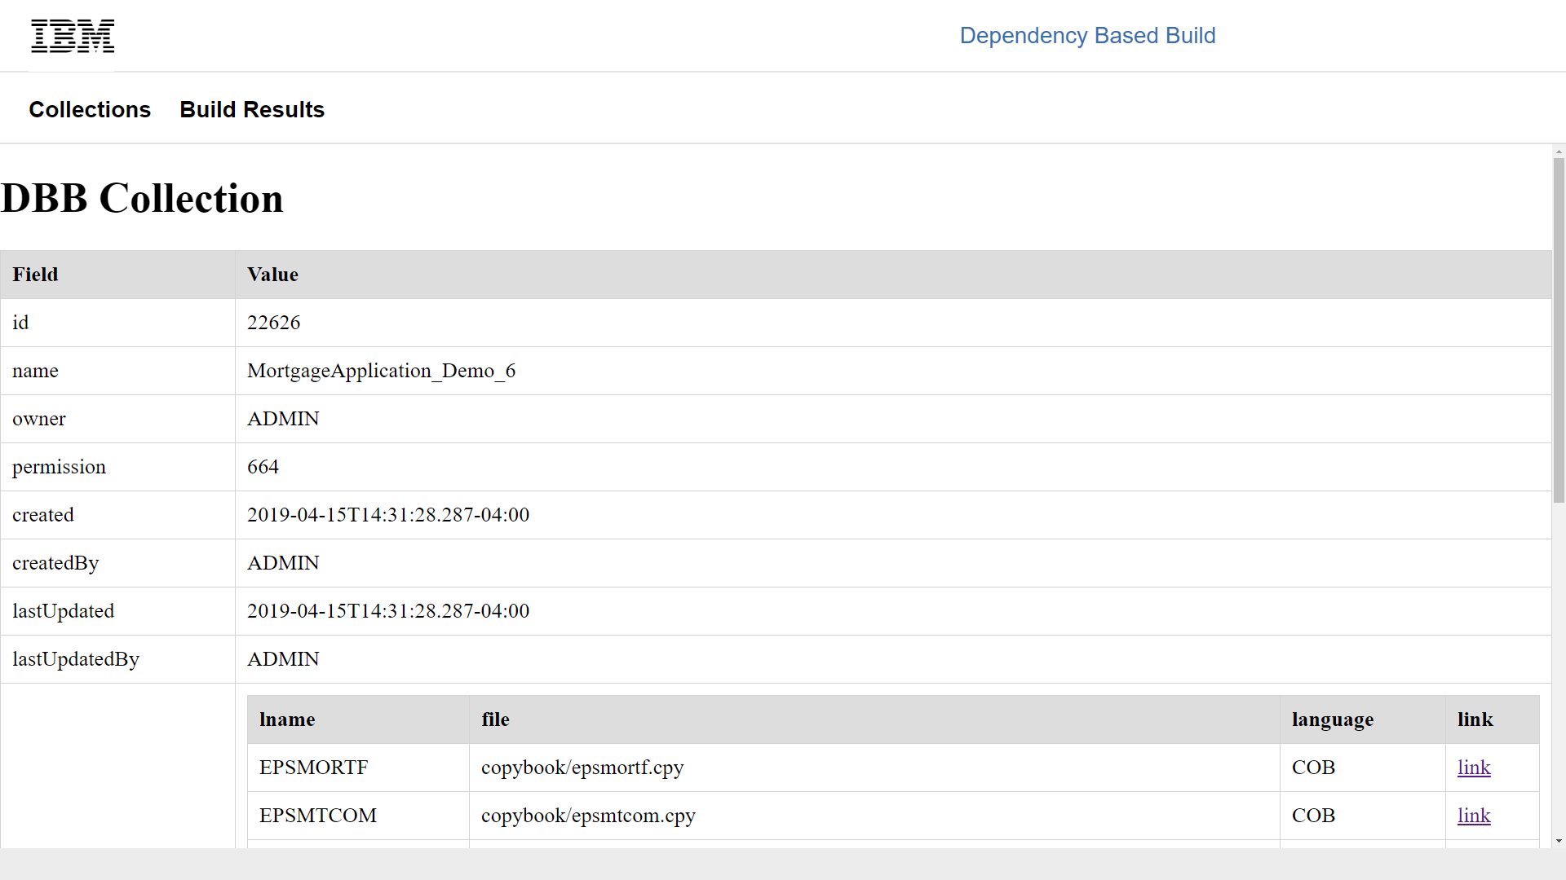
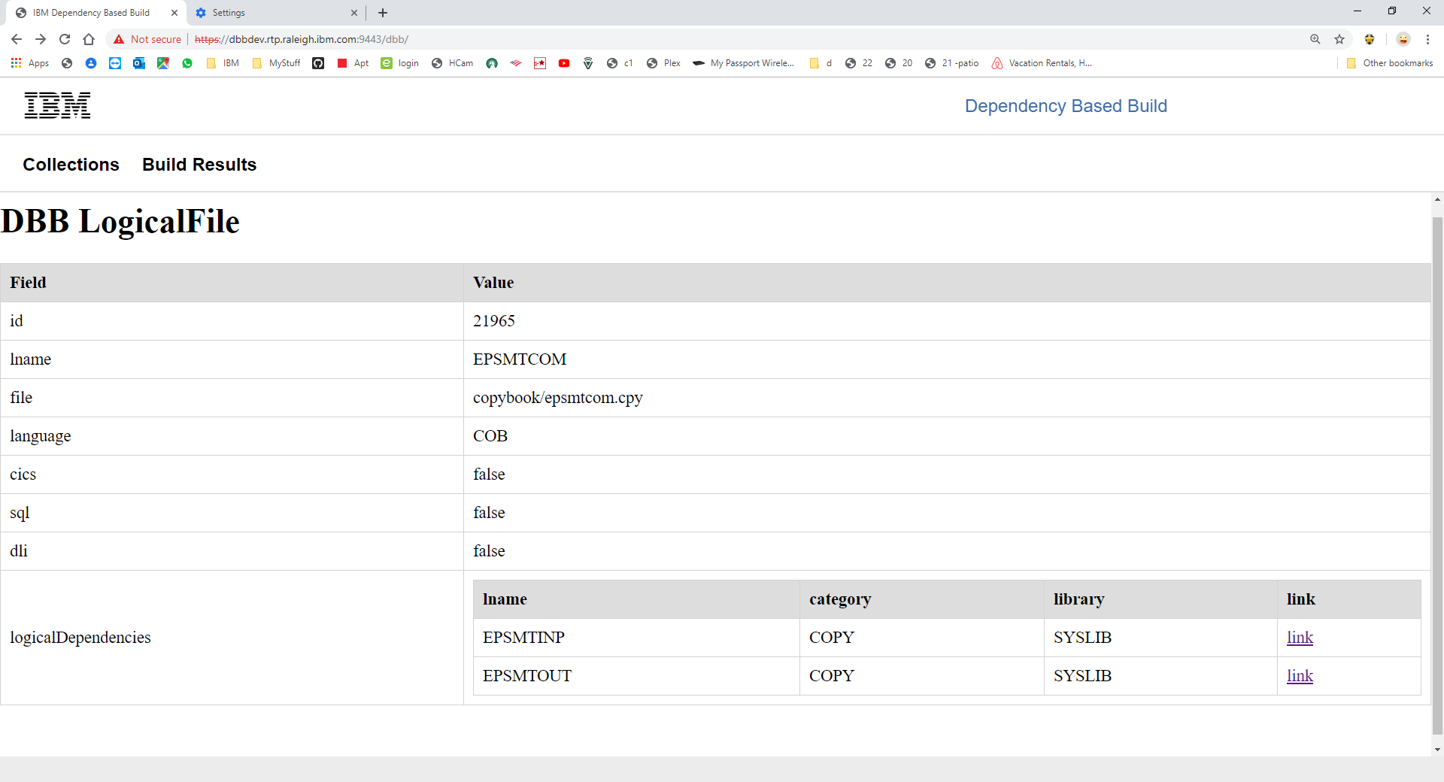
DBB’s WebApp - Application Metadata
DBB stores, maintains and queries your application’s program dependencies to other programs and source files like copybooks and BMS maps during a build.
Drill down for details

Slide 17
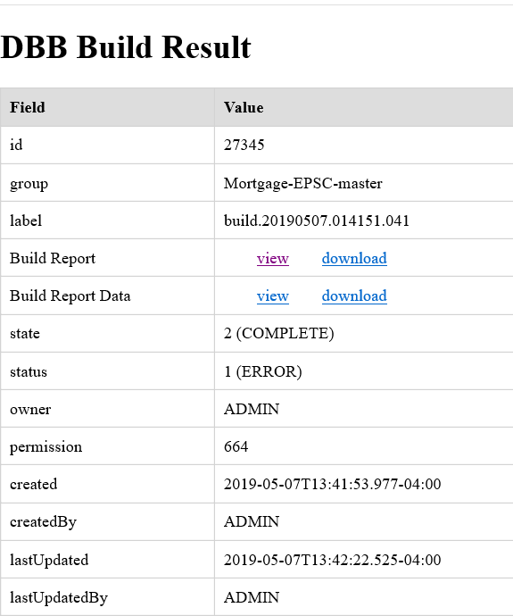
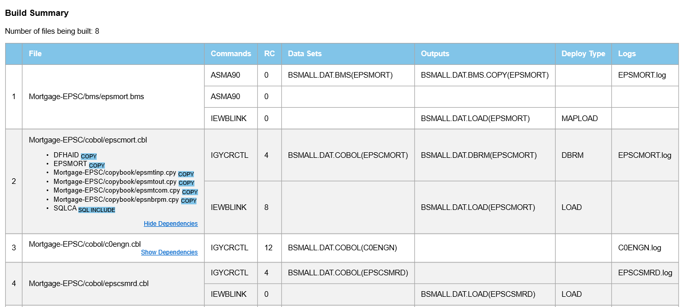
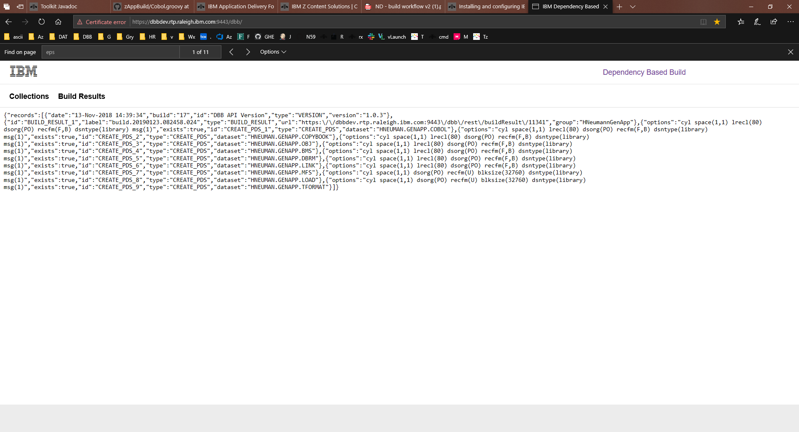
DBB’s WebApp – The Build Report
DBB generates build reports and creates a machine-readable JSON file to drive your automated Continuous Deployment (CD) process.

Slide 18
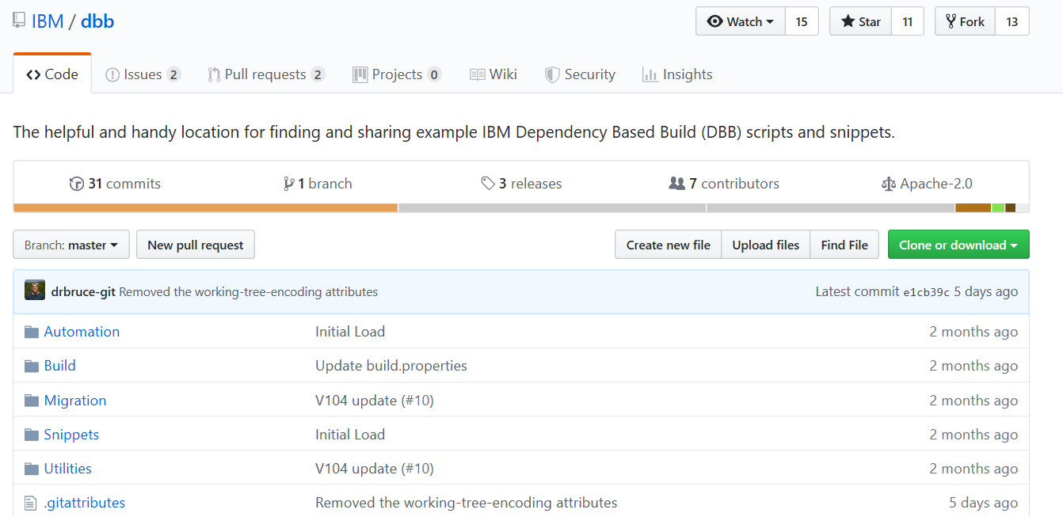
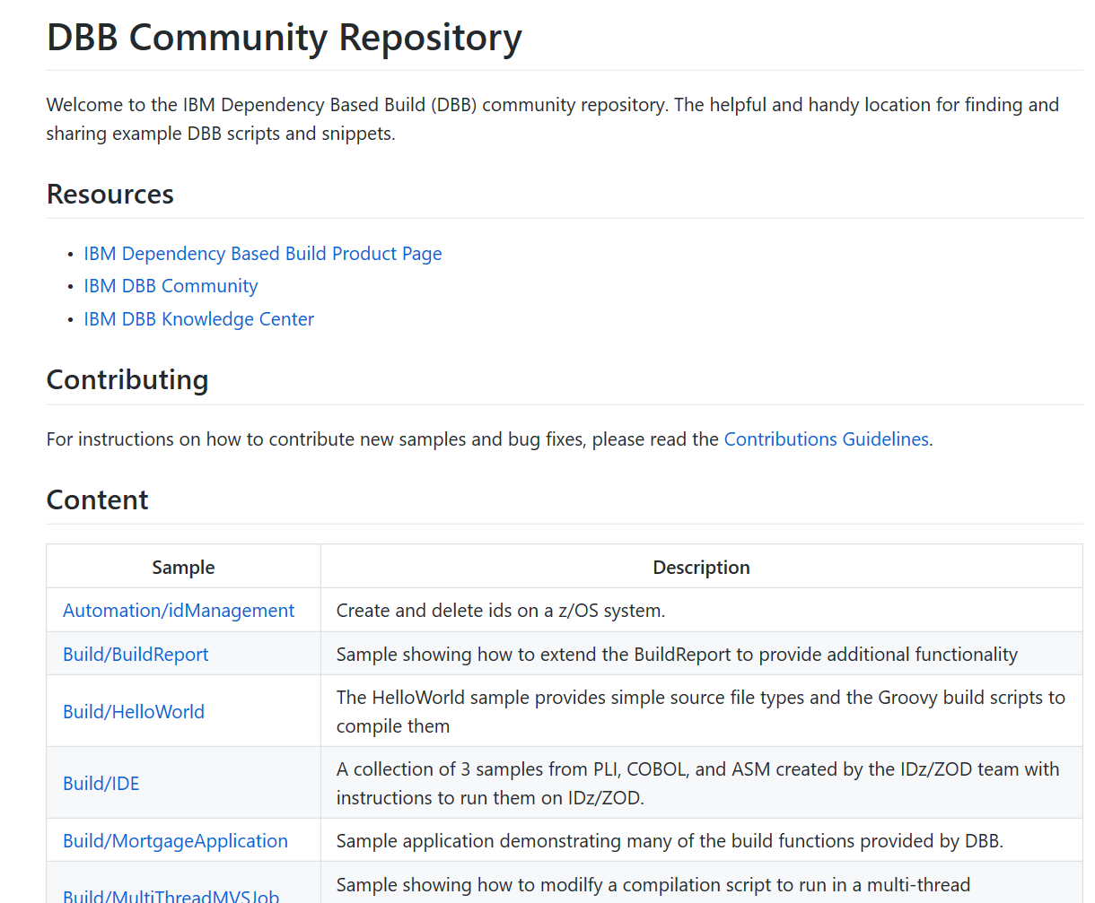
Find us on Git Hub - https://github.com/IBM/dbb
Samples, documentation and other resources
Case Study: https://developer.ibm.com/mainframe/2019/03/25/devops-transformation-on-ibm-z-with-git-and-ibm-dependency-based-build-a-case-study/

Slide 19
Migration Path from Current State to Git-DBB Solution

Slide 20





Migration process and tools
Questionnaire
BP/Client Tools
CI/CD Pipeline
SCLM Mig Toolkit
Import Tool
JCL Mig Tool
Application discovery (ADDI)
Analysis Tools
Extraction Tools
Scanner Tools
CI/CD
Migration Tools
Analyse
Extract
Componentize
CI/CD
Migrate
Analysis
Analyse the development process, Infrastructure and document the current state
Extract Metadata, Source Libraries, Compile Procedures and options, Languages, File types from Host SCM
Identify Interfaces and dependencies between applications and componentize
Derive future state architecture
Establish CI/CD workflow
Product deployment
Setup repos and Import
Setup the scripts and establish the pipeline

Slide 21
Breaking down the monolith - Interactions of applications
Application 1
Application 1 separates into public interfaces and its implementation
Application 2 follows the same mimic, but also uses services from App1 and App3. Therefore the configuration requires at least the interface description to be buildable
Public Interface of Application 1
Private Implementation of Application 1
Application 2
Application 3
Public Interface of Application 2
Public Interface of Application 3
Private Implementation of Application 2
Private Implementation of Application 3
Interface of Application 1
Interface of Application 3
Interface of Application 1

Slide 22
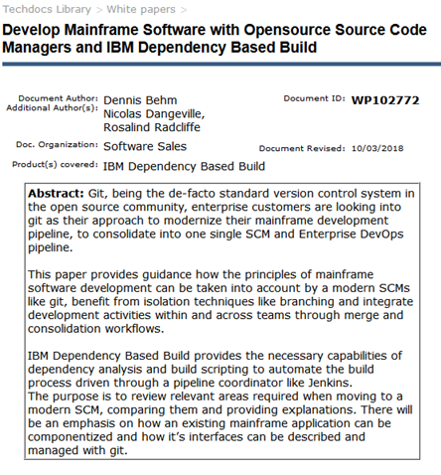
Git Migration White Paper
http://www-03.ibm.com/support/techdocs/atsmastr.nsf/WebIndex/WP102772
Moving from a legacy z/OS Library Manager to Git is not just about tools.
There are some key differences between traditional and modern SCM approaches.
This whitepaper is a synthesis of expert guidance learned in collaboration with mainframe development organizations.
Explains how to adopt and manage the transition at a process level.
Hash a special focus on how an existing mainframe application can be componentized and how the application interfaces can be described and managed, as well as built.

Slide 23
Simplify your Journey towards DevOps transformation through DevOps Acceleration Program(DAP)
DAP provides with expert advise on the best transformation approach for your enterprise, from any model to DevOps.
It includes how-to guides on culture, best practices, tools, training, and even sample code and architectures
Product Deployment
Deployment preparation
Rollout planning – Workflow and Use Case analysis
Assistance on Installation, Configuration, Optimization
Best Practices – in the areas of production Adoption
SCM Migration
Assessment of current state client setup
Transformation/Product workshop and Future state High level architecture
Representative Migration
Migration approach for future implementation
Knowledge transfer
For further details about the program, please contact
mfdevopsaccelerator@ibm.com , jayakarm@ibm.com

